Slide 1


Vet Buddy
Presenting by Christopher Henderson
and Jason Stuemke

Slide 2
Project Mission Statement
The program will be a mobile application(app). The primary user of the app will be Veterans (Vets). The app is designed to help Vets in a time of crisis, needing information or just looking for events to positively impact moral. The app will attempt to assist the user with a color tier system to the needs of the user.
The red tier will be immediate needs like calling a crisis line, 911 or local therapist or contact. Yellow tier will be looking for Veteran Administration facilities, comparing to the user’s location. The green tier will look for veteran events that is based in positive moral boosting. It will sort events by date within a certain distance.
Everything should be in a simple layout and easy button pushing operations.

Slide 3

Main Page
Emergency
Red: Looking for immediate help
Resource
Yellow: Looking for resource for a need
Support
Green: Looking for moral / social support

Slide 4
Red Page
Crisis Line
1: Press auto dials to a 1800 national crisis line
Call Bob
2: Auto dials to therapist or fellow Vet
911
3: Press and auto dials to ‘911’ for an emergency

Slide 5
Yellow Page
Clinics Directions
Clinics phone #
1: Press the phone number will auto dial to the number and directions will push to the map program
Nearest Clinics information
Hospital Directions
Hospitals phone #
Nearest Hospital information
2: Press the phone number will auto dial to the number and directions will push to the map program
Vet Center phone #
Vet Center phone #
Nearest Vet Centers information
3: Press the phone number will auto dial to the number and directions will push to the map program

Slide 6


Yellow Page
100 River Ave.
Eugene, Or
Clinics Directions
Clinics phone #
541-607-0897
Eugene CBOC
100 River Ave.
Hospital Directions
Hospitals phone #
913 NW Garden Valley Blvd.
Roseburg, Or.
541-440-1000
VA Roseburg Healthca
913 NW Garden Valley
Vet Center phone #
Vet Center phone #
Eugene Vet Center
190 East 11th Avenue
Eugene, Or.
190 East 11th Avenue
541-465-6918

Slide 7
Green Page
Centralized location for Veteran specific events
Make it easy to add to calendar and help with reminders
Give easy one stop shopping for events
There is no centralized location that events for Veterans is gathered outside of organizational calendars
Local events 20 miles
Event Date add to calendar
Event Date add to calendar
Event Date add to calendar
Event Date add to calendar
Event Date add to calendar
Event Date add to calendar
Event Date add to calendar
Event Date add to calendar

Slide 8
General Layout
Crisis Line
Call Bob
Emergency
911
Clinics Directions
Clinics phone #
Nearest Clinics information
Resource
Hospital Directions
Hospitals phone #
Nearest Hospital information
Vet Center phone #
Vet Center phone #
Nearest Vet Centers information
Support
Local events
Event Date add to calendar
Event Date add to calendar
Event Date add to calendar
Event Date add to calendar
Event Date add to calendar
Event Date add to calendar
Event Date add to calendar
Event Date add to calendar

Slide 9

Question/Comments

Slide 10
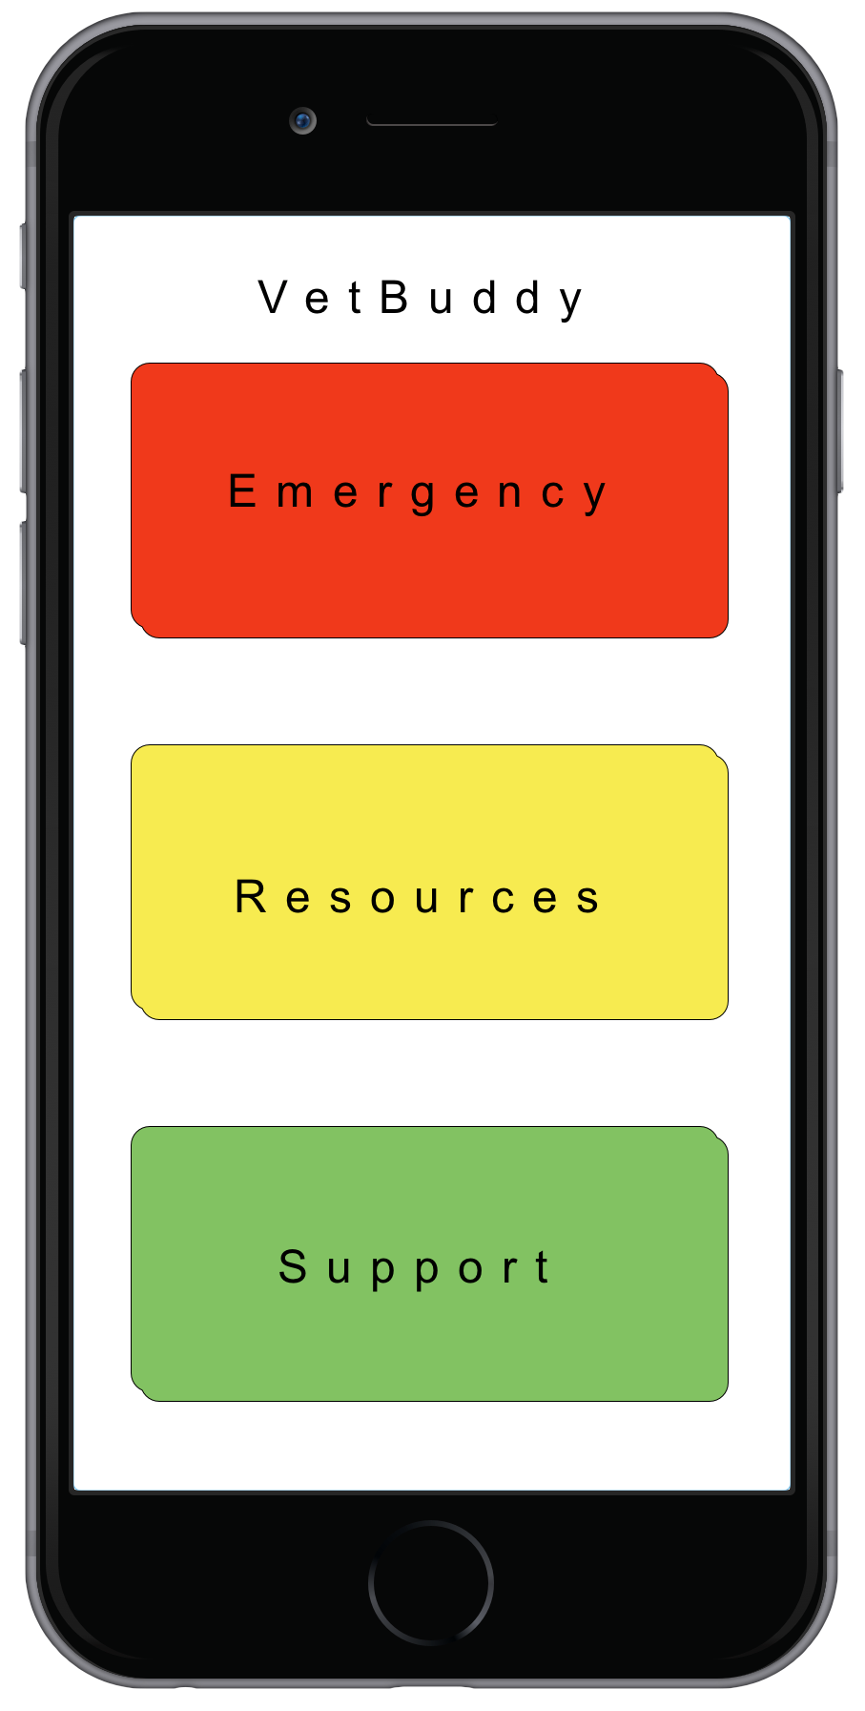
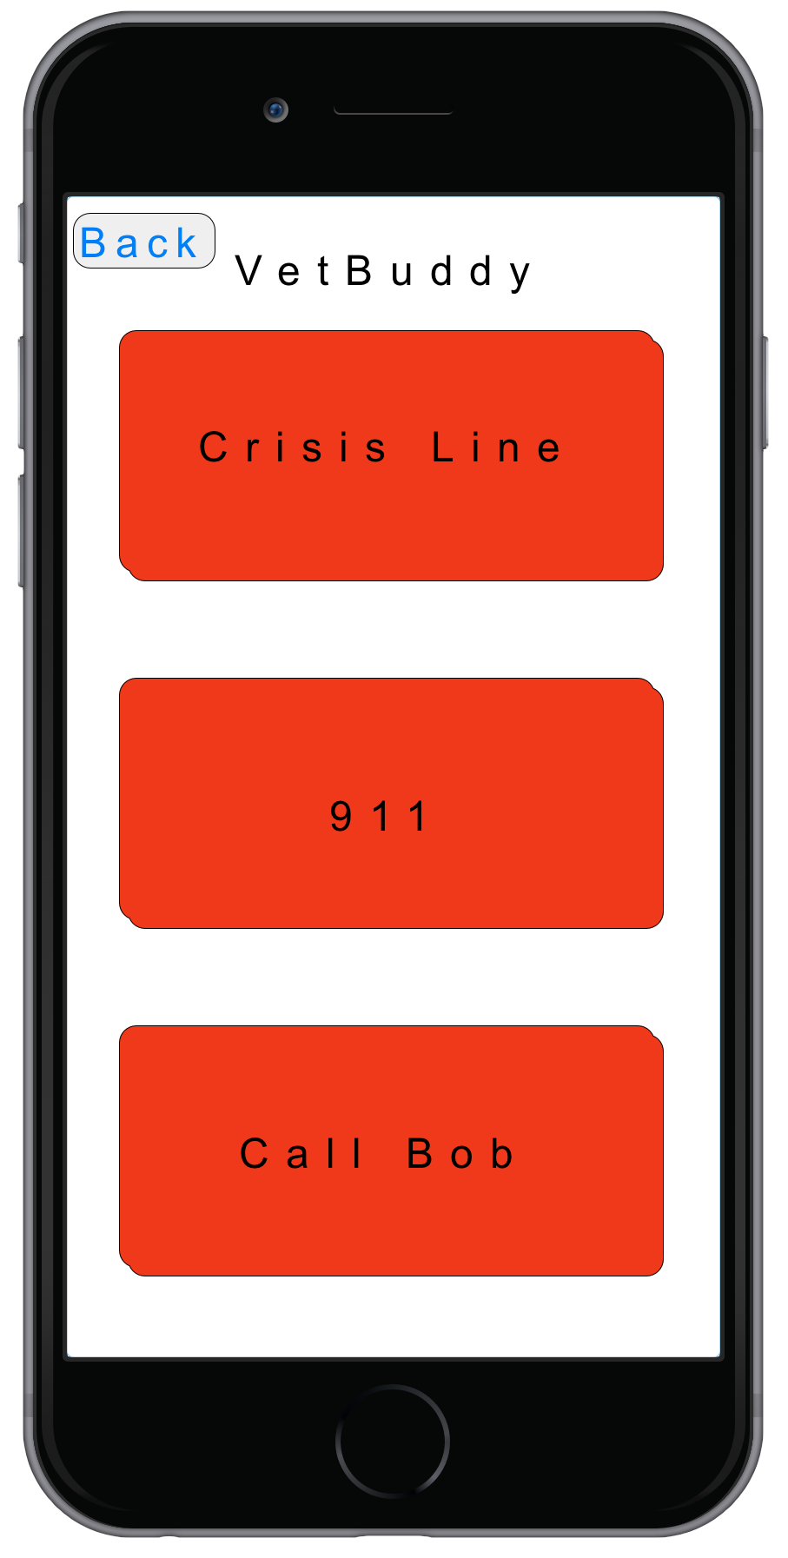
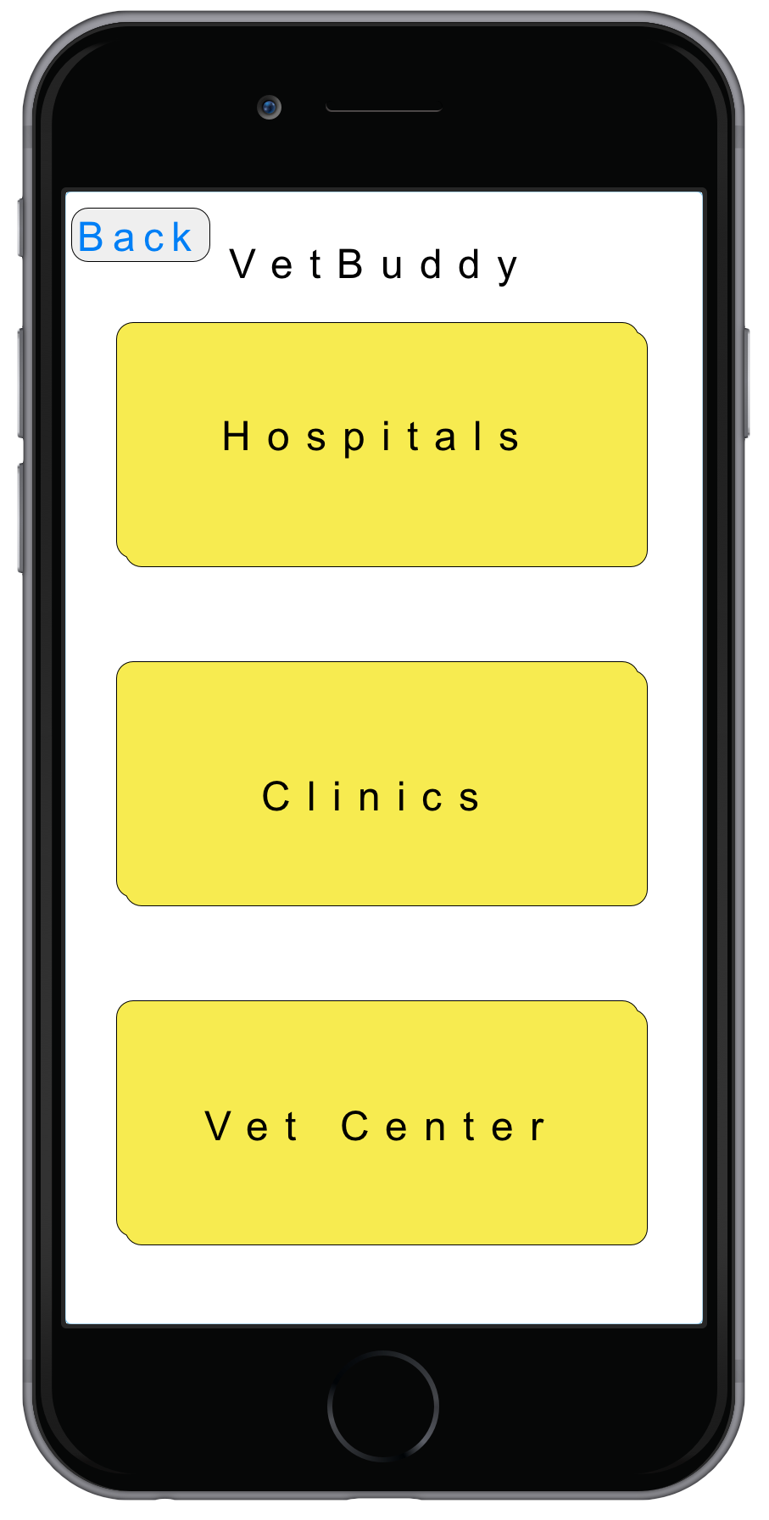
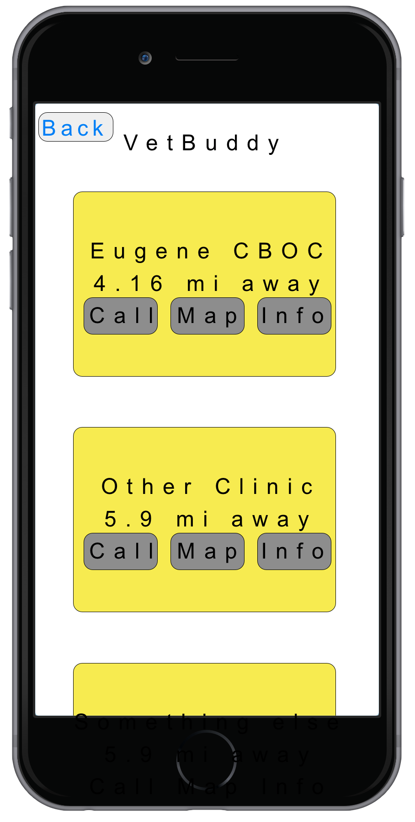
JSON
JSON
Figure 2 - visual overview of System Architecture

